Slide 1

Body Mechanics and Proper Lifting
By:
Heidi Wendtland ATC/L, CEASI

Slide 2
Agenda
Injury Prevention
Safe Lifting Techniques and Proper Body Mechanics
Stretching
Staying Fit and Healthy

Slide 3
Which lift is the hardest?
Best way to lift Hardest way to lift

Slide 4
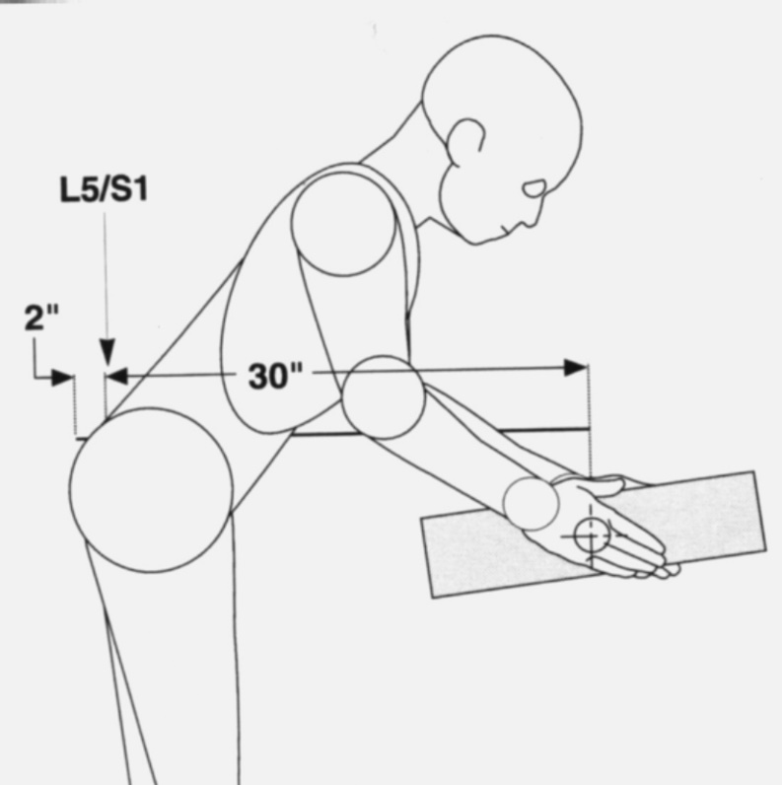
Proper Lifting
Biomechanics of Lifting
Plan the Lift
Wide Base of Support
Head up
Bend Knees, Not Back
Keep Object Close
Avoid Twisting
Keep shoulders, hips and feet facing the same direction as each other

Slide 5
Proper Lifting
Lifting a load out in front of you, as shown, will place a significant load on the spine
The load at the base of the spine can exceed 10 to 20 times the load being lifted
The load at the base of the spine is directly related to the length of “Lever Arm” of the lift.

Slide 6
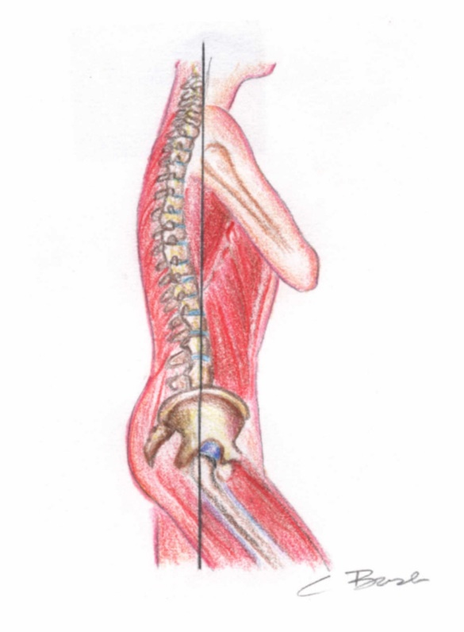
Posture and the low back
The more forward flexed you are, the greater the disc pressure
Higher disc pressures correspond to a greater likelihood of disc injury
Maintain upright postures

Slide 7
Stretching
As we work throughout the day in various postures and positions, the demand for blood flow increases. Stretching helps to reduce the damage done by repetitive exertions, sustained positions, awkward postures, and forceful activities. Tissues are flexible…kind of like the difference between a wet sponge and a dry sponge.
Areas to target for stretching…
Neck/Shoulders
Upper Back
Lower Back
Shoulders
Legs

Slide 8
Thank You!

